Slide 1
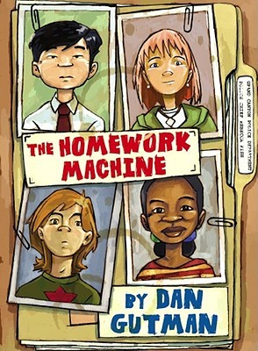

Math Expression Recognition
(MER)
Special Topics in Robot Vision
May 6, 2020

Slide 2
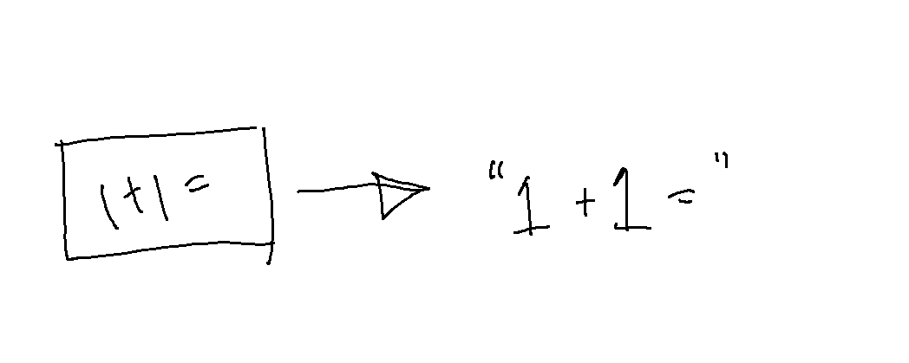
but WHAT IS MER?????
read string from image
(but it’s math)

Slide 3
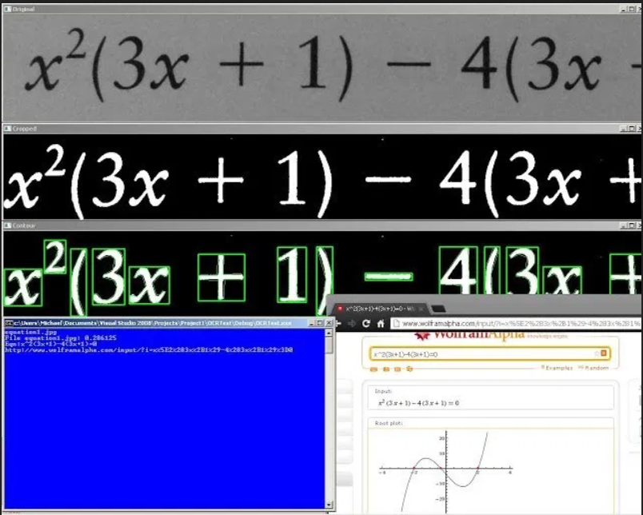
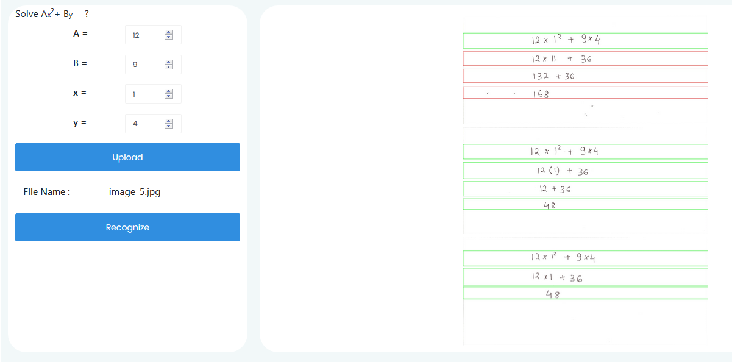
Application of MER
Handwritten Math Autograder
Grapher

Slide 4
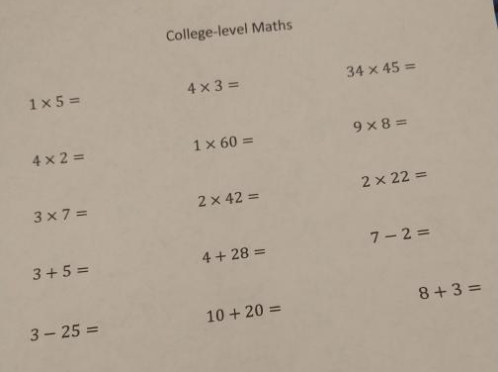
So what if……
we coded something to provide solutions to college-level math? :D
I lied it’s not college level

Slide 5
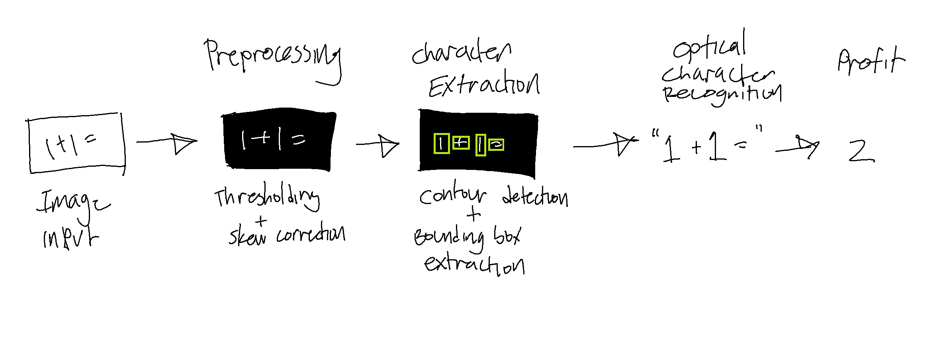
OCR Process

Slide 6


libraries used:

Slide 7
Input
Getting the math problem into a bite-sized chunk

Slide 8
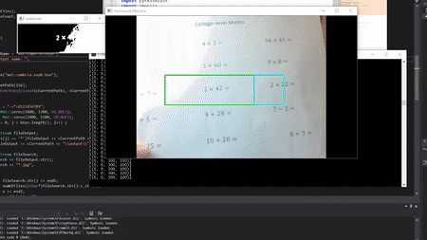
Helen’s webcam doing an atrocious job, colorized 2020
(I think it would have more success with a phone camera because of lighting though)

Slide 9
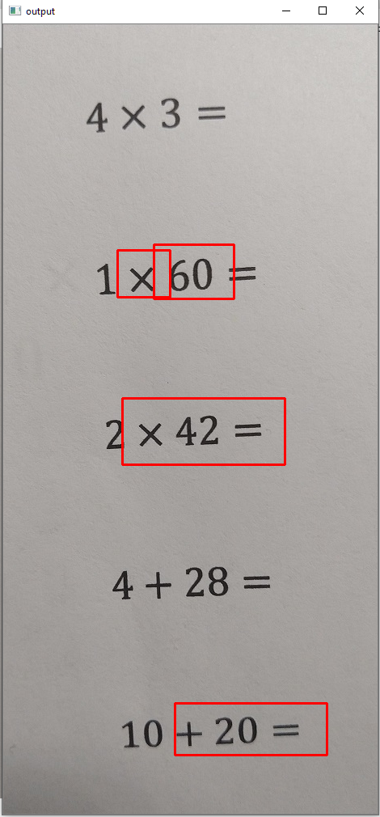
EAST doing an equally atrocious job, colorized 2020

Slide 10
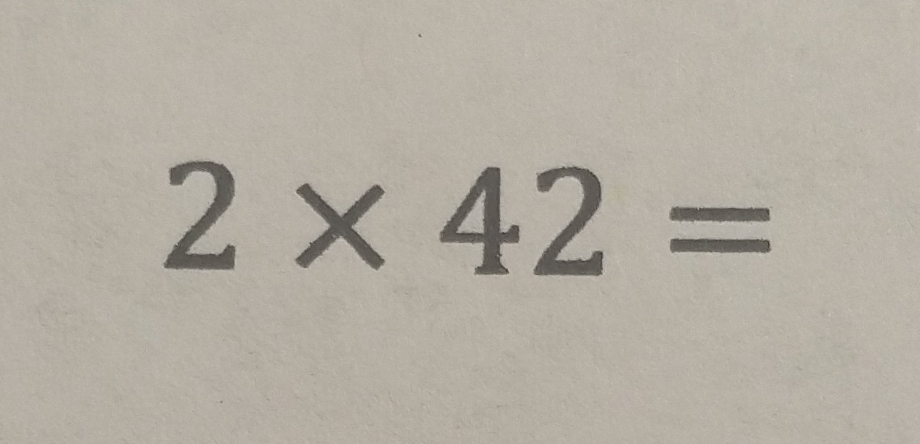
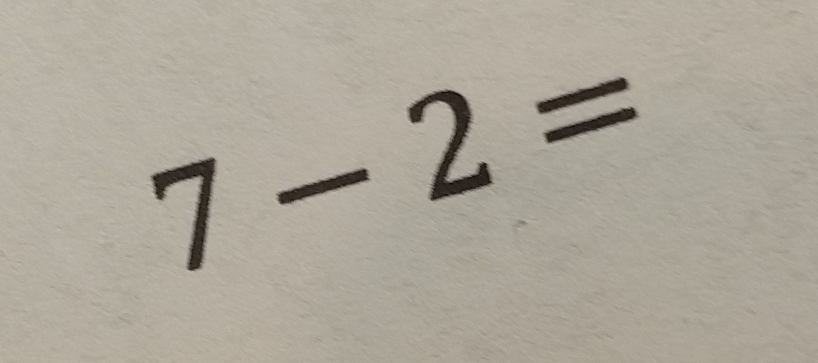
Final input image: pre-cropped equation

Slide 11
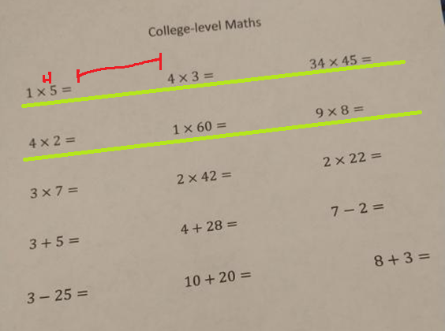
in retrospect
I probably could’ve implemented something that took advantage of lines and spacing, huh ☺
(like a horizontal line scan to find empty spaces between problems to separate them, or merge bounding boxes by horizontal distance)

Slide 12
Pre-Processing
Making the bite-sized chunk easier to read for the computer

Slide 13
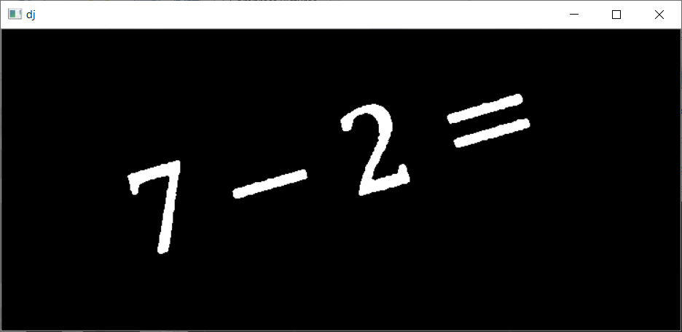
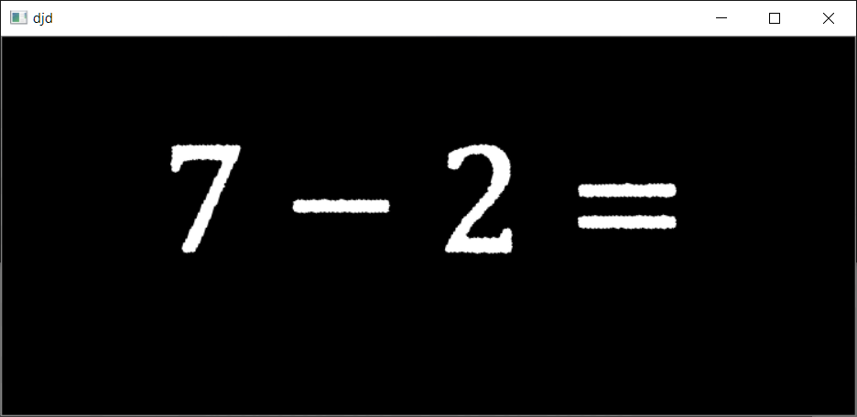
Image Pre-processing
Original Image
Grayscale, Gaussian Blur + Otsu Thresholding
(for ease of reading since it reduces each pixel to a binary value)
Rotation Correction
(because tesseract bad at reading rotated characters)

Slide 14
Character Extraction
Splitting the bite-sized chunks into bitier-sized chunks for character recognition

Slide 15
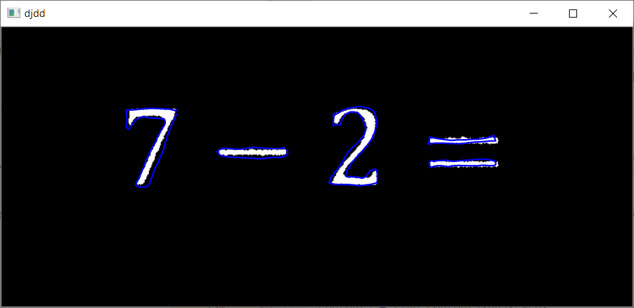
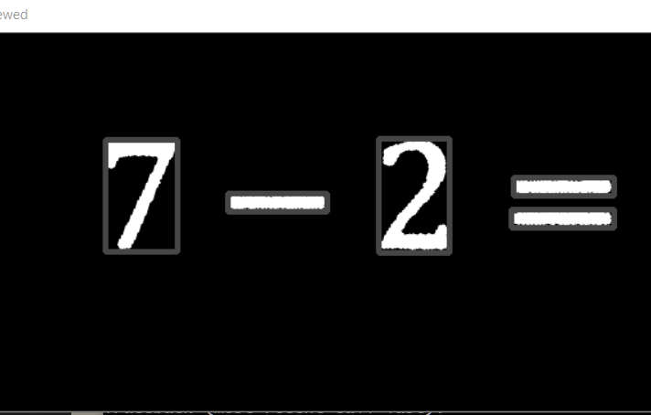
Character Extraction
Contours (artist’s rendition)
filter out contours that are too small (noise)
Bounding Boxes
(since an equals sign is two parts, it gets
two bounding boxes, which needs to be fixed –
more on that later)

Slide 16





The result!
Easily extractable
math symbols using bounding boxes

Slide 17
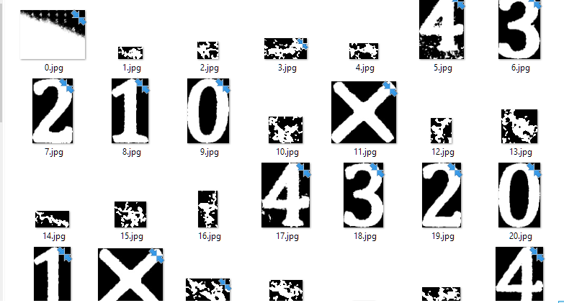
…Most of the time
One of my images was shadowy and this happened

Slide 18
OCR (Optical character recognition)
Reads the bitier-sized chunks into strings

Slide 19
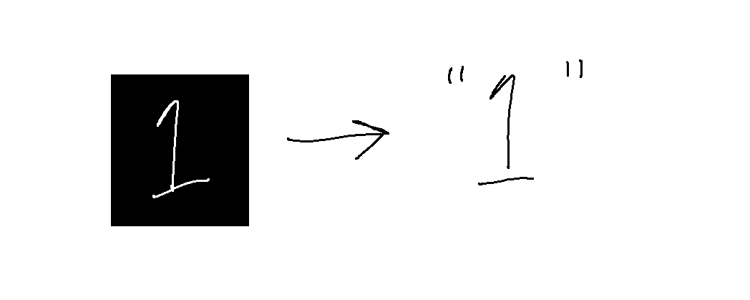
Tesseract
Takes arguments through the command line to process images
Multiple modes of input
(for max accuracy, we use the single character mode to process one character at a time)

Slide 20
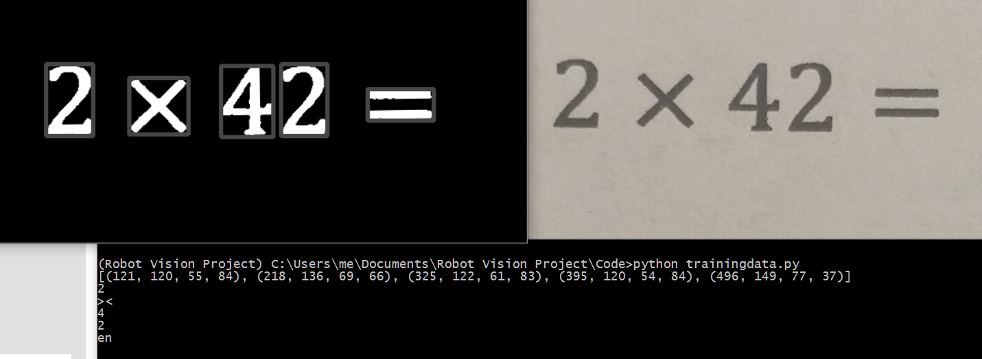
Default tesseract doing an awful job

Slide 21
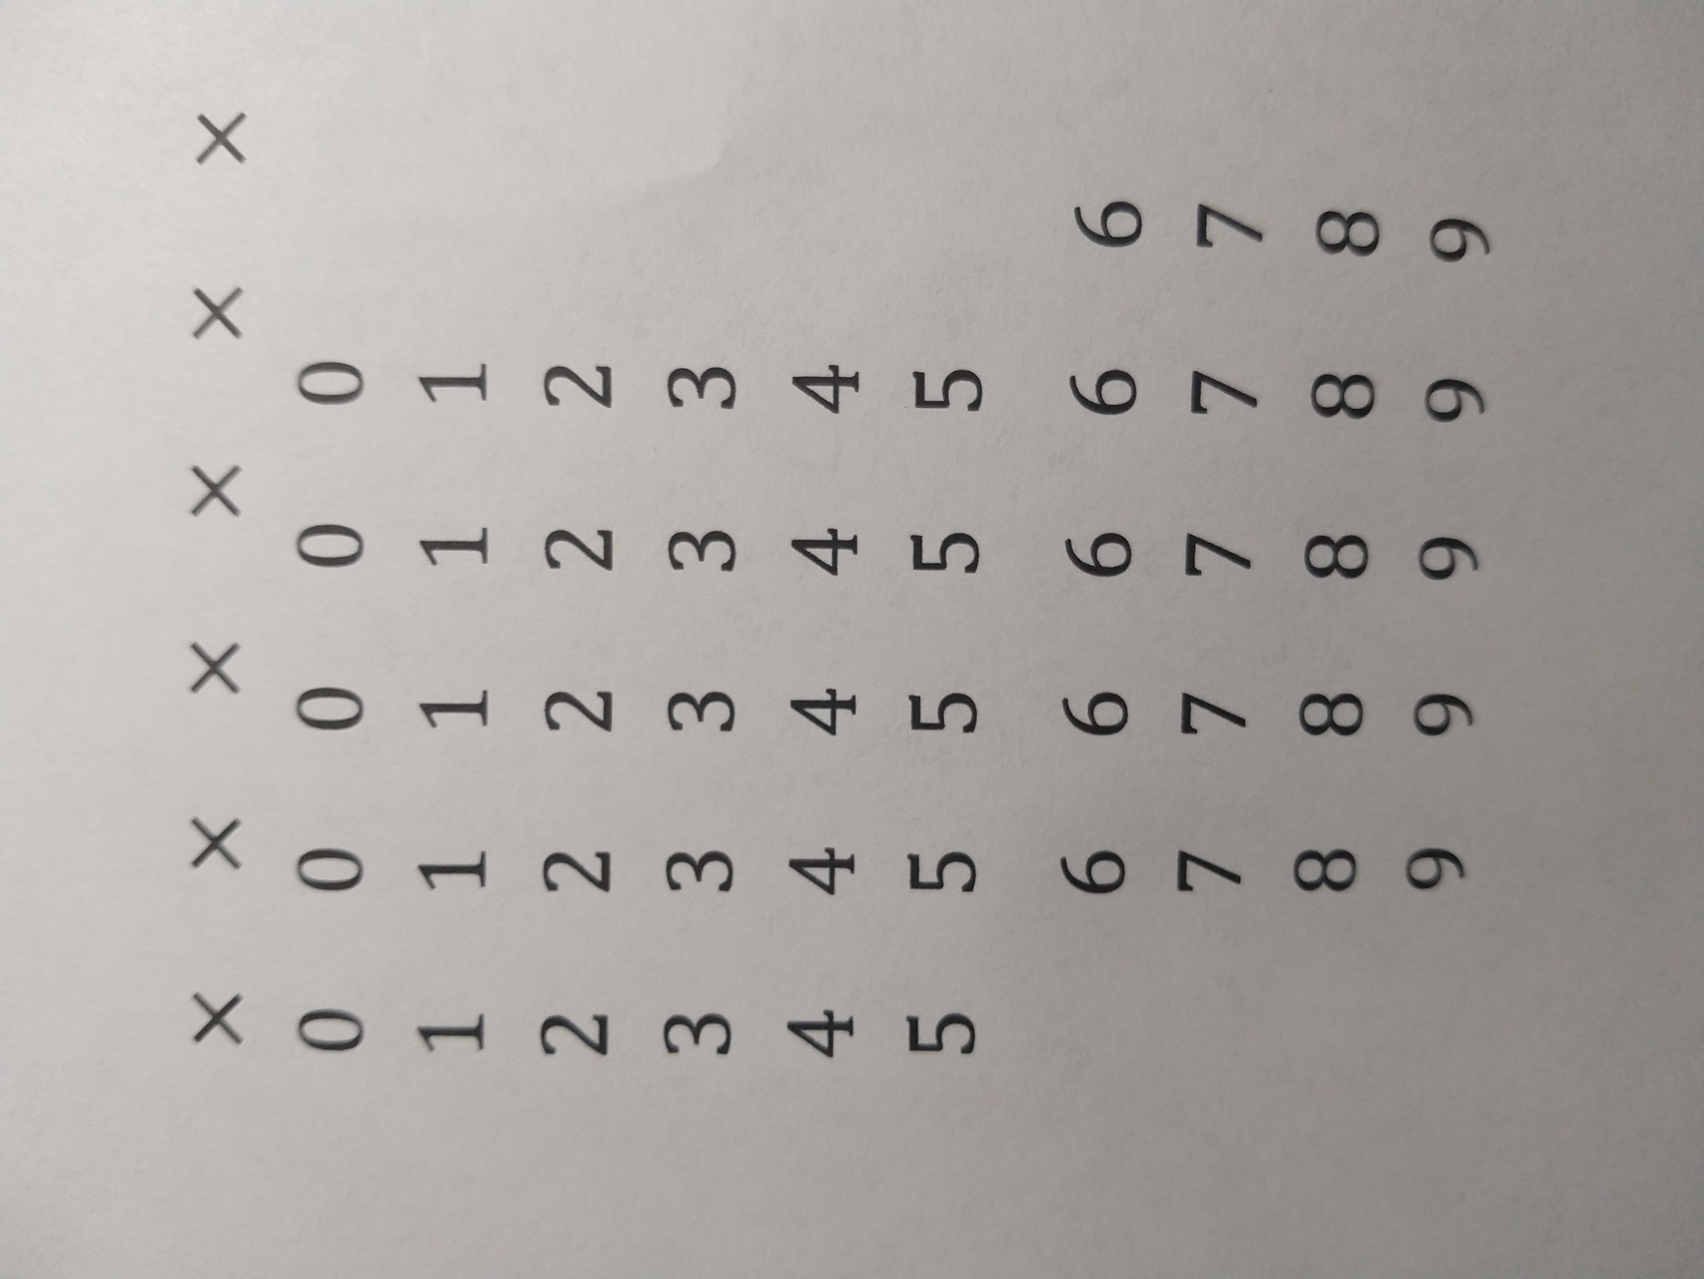
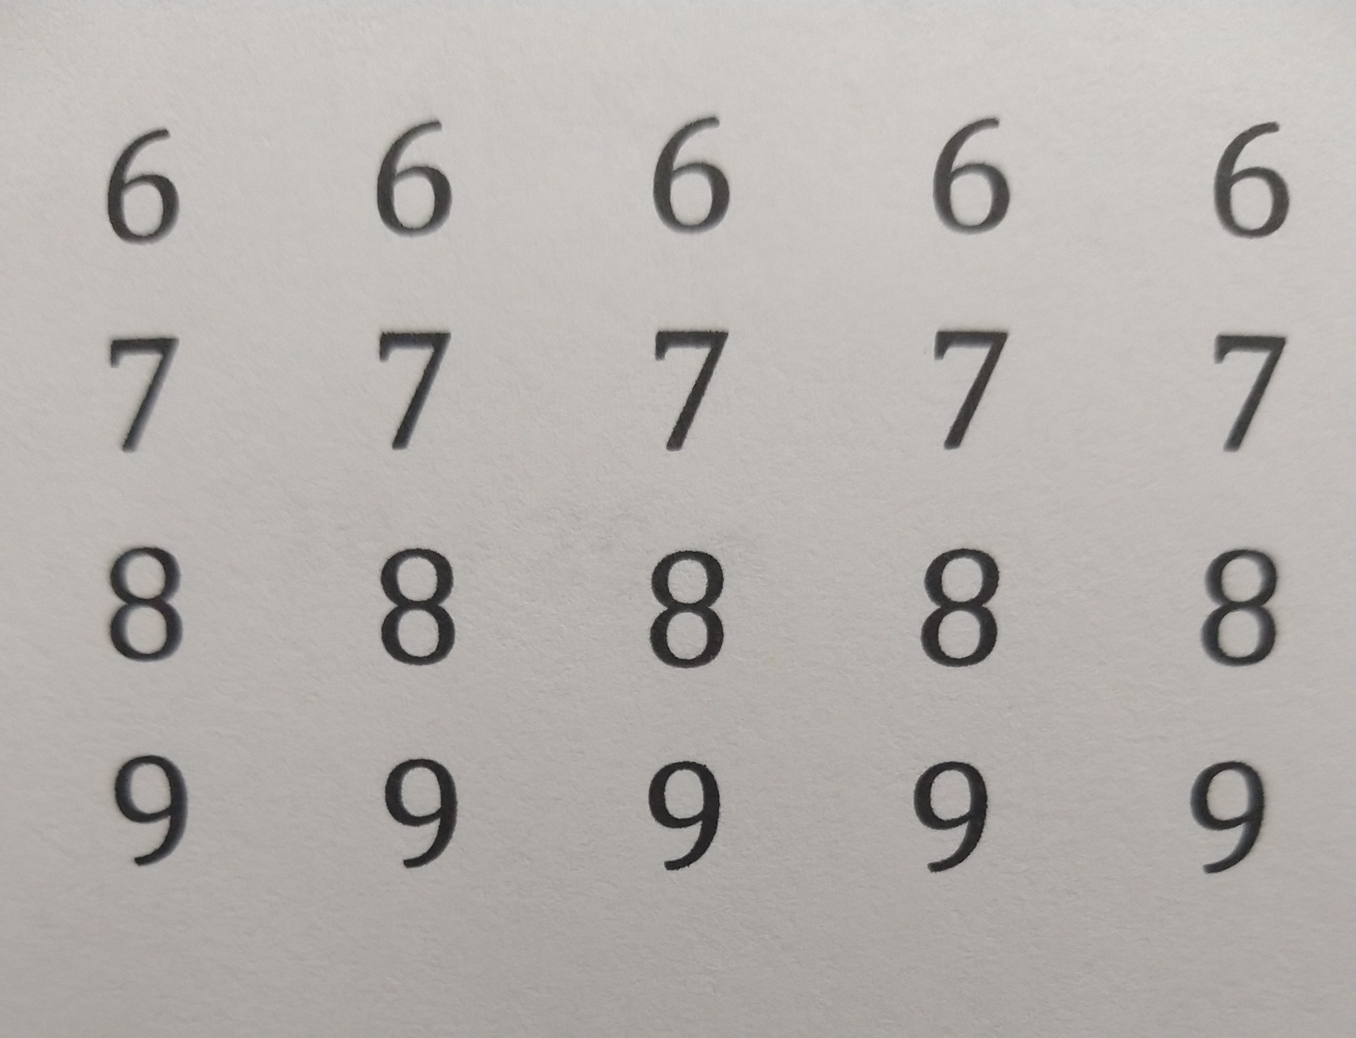
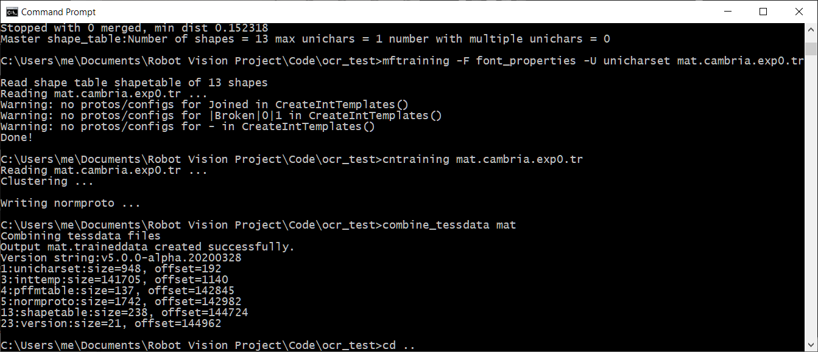
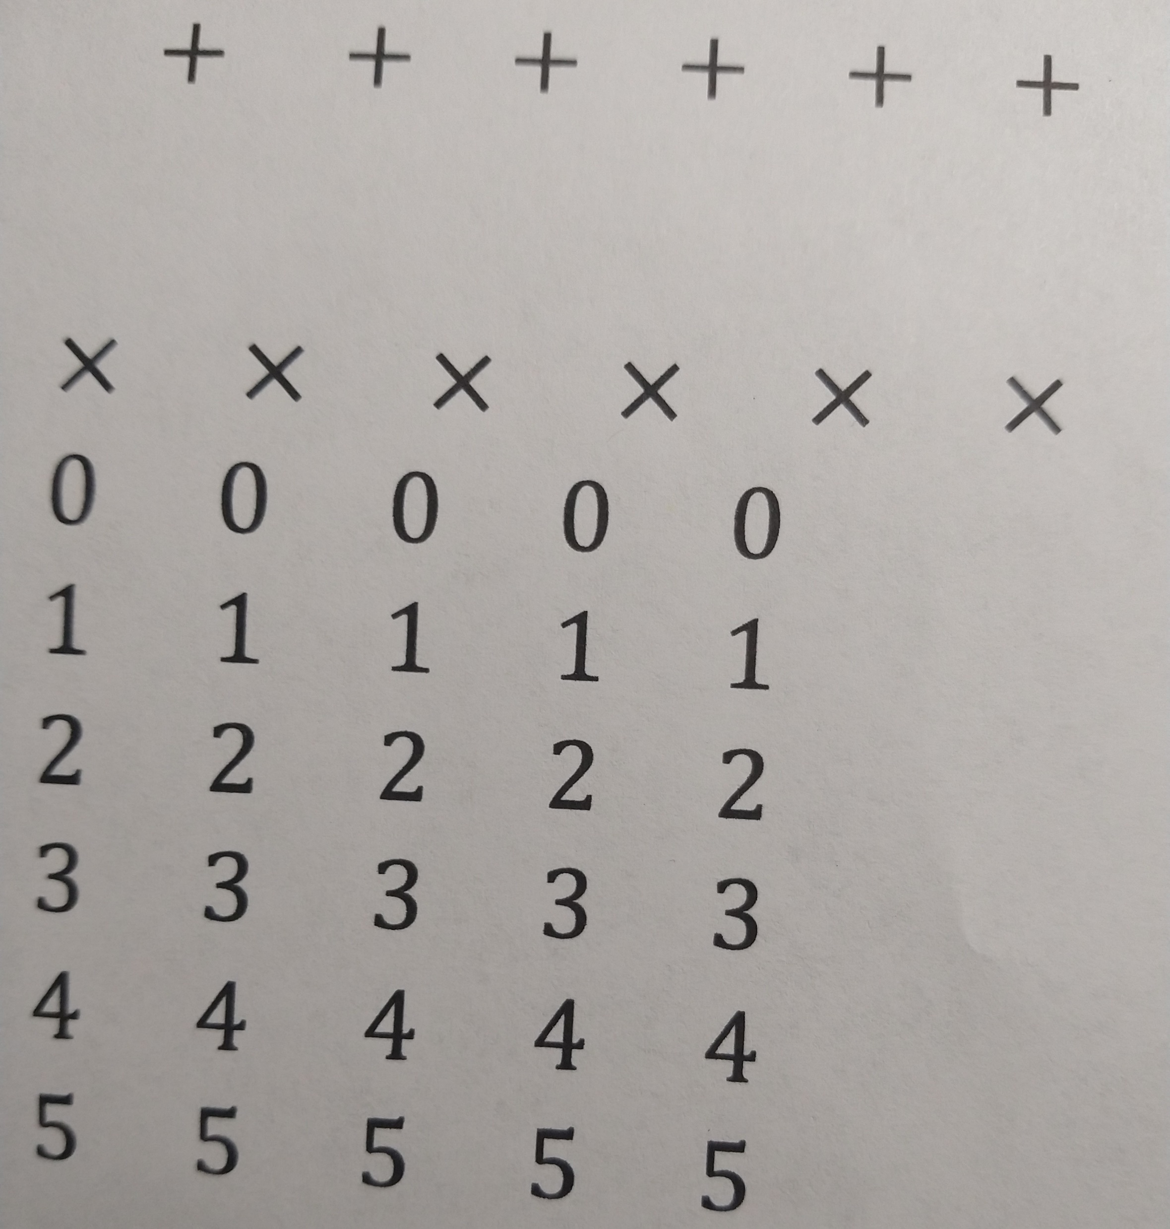
How to Train your Tesseract
Take multiple pictures for training data
Train the neural net
Generate training files

Slide 22
How to Train your Tesseract
PROFIT
Take multiple pictures for training data
Train the neural net
Generate training files

Slide 23
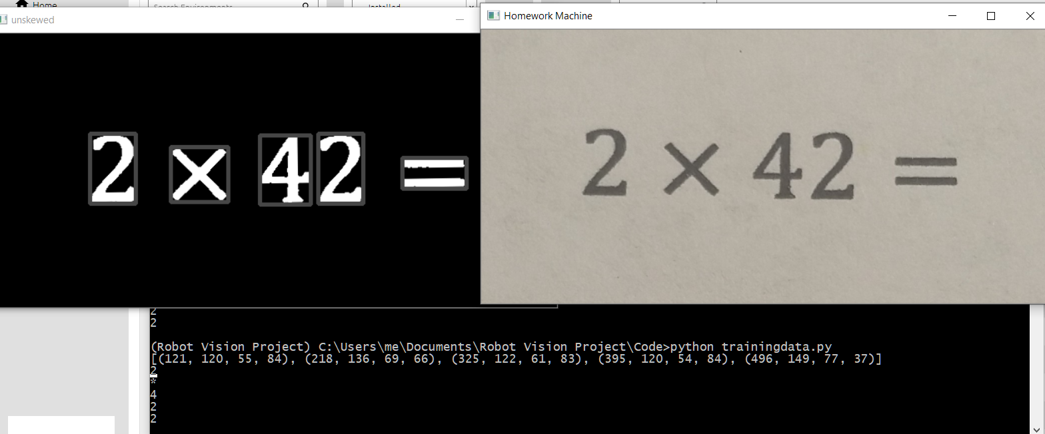
Retrained Tesseract doing a better job

Slide 24
Equal signs are basically two dashes on top of each other
(and yet tesseract can’t recognize them)
…So check for equals signs while iterating through bounding boxes and handle it as a special case
(this is also why I left out division signs for now)

Slide 25
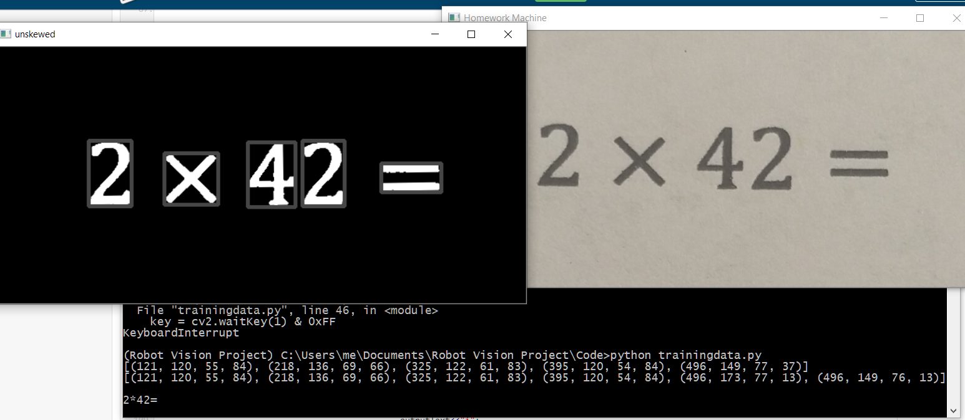
Tesseract doing an even better job with pre-processed equal signs

Slide 26
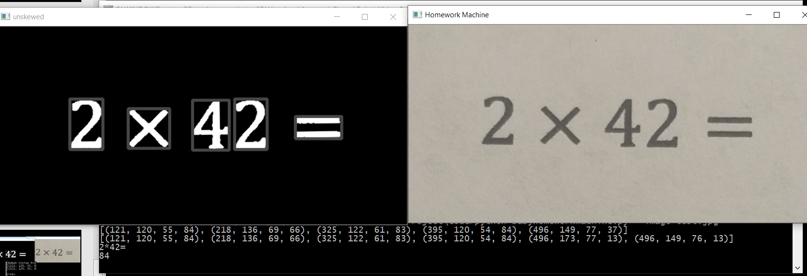
Voilà!
(My intuition is that if this code does scan in an entire math worksheet, it should
be able to distinguish math problems from non-math problems and ignore them)

Slide 27
Where to go from here:
Recognize more math symbols (eg. radicals, exponents)
Implement a better way to read off the worksheet
Filter math problems from non-math problems

Slide 28
What I learned from this project and the course:
From the course:
In general, how to process images as numerical data
Matrices, color correction, perspective
the various applications of processing images
eg tracking, 3D reconstructions
The Fundamental Matrix Song was a banger
From the project:
a lot of image processing is just applying math to arrays
Rectangles are powerful
Microsoft Visual Studio is annoying

Slide 29
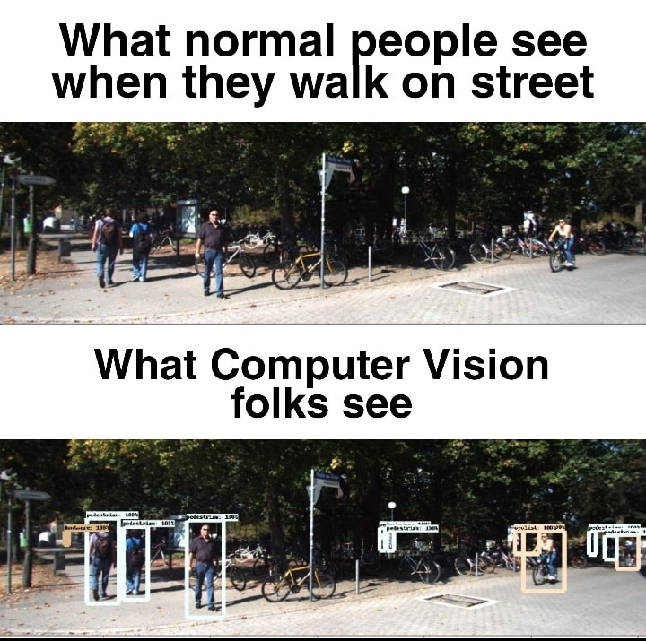

THANKUUUUUU

Slide 30
Tutorials/references
Math OCR paper: http://par.cse.nsysu.edu.tw/~algo/paper/paper16/B2_1.pdf
EAST text detection: https://www.pyimagesearch.com/2018/08/20/opencv-text-detection-east-text-detector/
Skew correction: https://www.pyimagesearch.com/2017/02/20/text-skew-correction-opencv-python/
Tesseract Training for Math OCR: https://blog.ayoungprogrammer.com/2013/01/equation-ocr-part-2-training-characters.html/

